Slide 1
Mitochondria
The two membranes of Mitochondria
Outer Membrane – Porous in Nature
Inner Membrane – Deeply Folded
The Inner Membrane of Mitochondria called as Cristae Facilitates Generation of ATP molecules as it has a larger surface area.

Slide 2
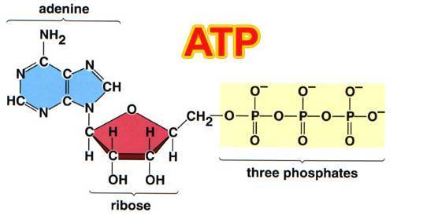
Energy currency
It is a double membrane
organelle which has its own DNA and
that is why often called
Semi Autonomous Organelle’
The cell requires energy in order to carry out several activities. This energy is generated by mitochondria which are often called as the ‘Powerhouse’ of the Cell. Mitochondria are site of cellular respiration. They use oxygen from air to oxidise the carbohydrates and thereby release energy.
The Mitochondria generates ATP (Adenosine Triphosphate) which are energy giving molecules of the cell that are often called as their ‘Energy Currency’.

Slide 4
Plastids

Slide 5
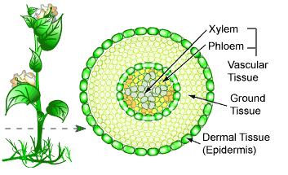
Leucoplasts
1. Amyloplast
They are found in tubers, cotyledons and endosperm in plants.
They are used to store starch.
2. Elaioplast
They are found in epidermal cells of the plants
They store oil.
3. Proteinoplast
They are found in seeds and nuts.
They store proteins.

Slide 6
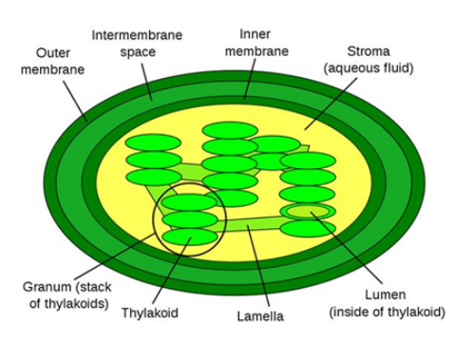
Chloroplast

Slide 7
Chloroplasts
Chloroplasts are cell organelles that conduct photosynthesis in plants.
Chloroplast is derived from two Greek words Chloro and Plasts which means green and plants respectively.
Chloroplasts contain photosynthetic pigments called ‘Chlorophyll’ along with lipids, carbohydrates, minerals, DNA, RNA, grana, thylakoids and stroma.
The main functions of chloroplasts are:
Conducting photosynthesis in plants.
Protein synthesis
Releases oxygen
Storage of Starch

Slide 8
Light-dependent Reactions in Photosynthesis – During photosynthesis chlorophyll absorbs the light energy which is then used to for two molecules ATP and NADPH (nicotinamide dinucleotide phosphate)
Thylakoids – They are pillow shaped compartments in the chloroplast. The light-dependent reactions in photosynthesis take place in the thylakoids.
Stroma – It is a fluid-filled matrix in the chloroplasts. It is colorless fluid that contains all the enzymes that are needed for the light-dependent reactions in Photosynthesis.
Grana – Stacks of thylakoids are called Grana. They are found in the stroma. They provide a large surface area so that the reactions of photosynthesis can take place.

Slide 9
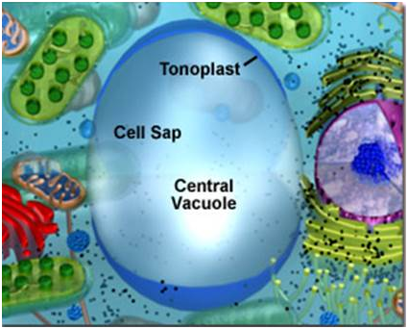
Sap Vacoules
These vacuoles are filled with a fluid called Vascular Sap.
The fluid contains Amino Acids, Salt, Sugar, Proteins, Water, and Waste Materials. Sap vacuoles are separated from the cytoplasm by a semi-permeable membrane called Tonoplast.
Their main function is to allow rapid exchange between cytoplasm and the surrounding environment.
A number of sap vacuoles are found in young plant cells and animal cells. In mature plants the small sap vacuoles combine together to form a single large central vacuole.

